Slide 1
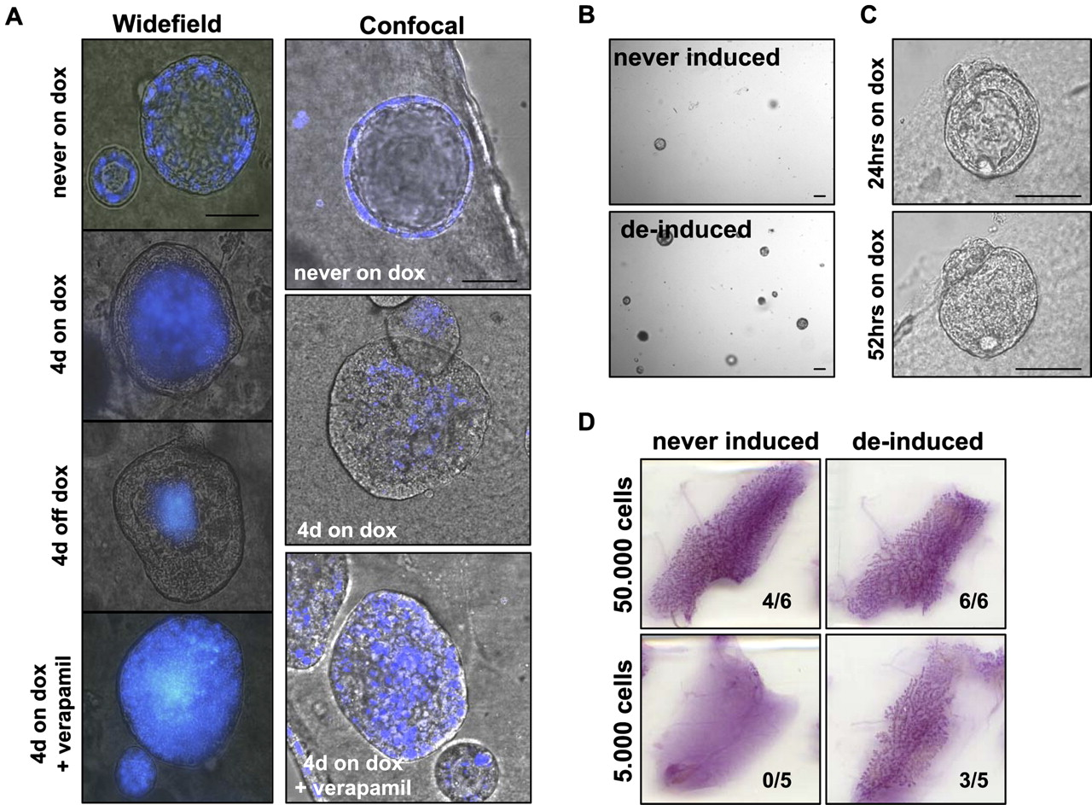

Cells surviving oncogene withdrawal acquire mammary progenitor cell characteristics.
Jechlinger M et al. Genes Dev. 2009;23:1677-1688
©2009 by Cold Spring Harbor Laboratory Press
Notes:
Cells surviving oncogene withdrawal acquire mammary progenitor cell characteristics. (A) Spheres grown from tritransgenic primary mammary cells were incubated with Hoechst 33342 for 1 h at indicated time points and monitored for exclusion of dye the next day. (Top panels) Fluorescent microscopy. Acini never exposed to doxycycline for 12 d retain the Hoechst staining (left panel), while the cells at the rim of spheres treated with doxycycline for 4 d (left middle panel) as well as cells surviving doxycycline withdrawal (4 d doxycycline and subsequently weaned for 4 d from doxycycline; right middle panel) exclude Hoechst 33342. (Right panel) Treatment with verapamil (50 μM) blocks the ability to pump out Hoechst. (Bottom panels) Confocal microscopy projections (5-μm depth, 10 optical sections through the middle of a sphere) at the indicated time points show the same results. (Left panel) Acini never exposed to doxycycline for 8 d retain the Hoechst staining. (Middle panel) Cells at the rim of solid spheres treated with doxycycline for 4 d exclude Hoechst 33342. (Right panel) Cells at the rim of solid spheres treated with doxycycline and Verapamil for 4 d fail to exclude Hoechst 33342. Bars, 50 μm. (B) Bright-field pictures show a typical field to compare the reseeding capacity of 1000 cells harvested from tritransgenic spheres that had never been exposed to doxycycline (top panel) versus 1000 cells harvested form surviving spheres after doxycycline withdrawal (bottom panel). Bar, 100 μm. (C) Bright-field pictures show that acini grown from reseeded cells are still responsive to doxycycline induction. (Top panel) Typical acinus grown from reseeded cells 24 h after doxycycline induction. (Bottom panel) The same acinus 52 h after doxycycline induction Bar, 50 μm. (D) Cells harvested from spheres after doxycycline withdrawal were tested for their capacity to repopulate the cleared mammary fat pad of Rag1−/− mice (right panels) and compared with cells harvested from spheres that were never treated with doxycycline (left panels). Either 50,000 single cells (top panels) or 5000 single cells (bottom panels) were injected from a given population. Inserts indicate numbers of successful engraftments over numbers of injected mammary glands and represent the sum of two independent experiments.

